Slide 1
Transformer Architecture
Bakul Gohel, Ph.D.
DA-IICT, Gandhinagar
Source for transformer images: https://jalammar.github.io/illustrated-transformer/

Slide 2
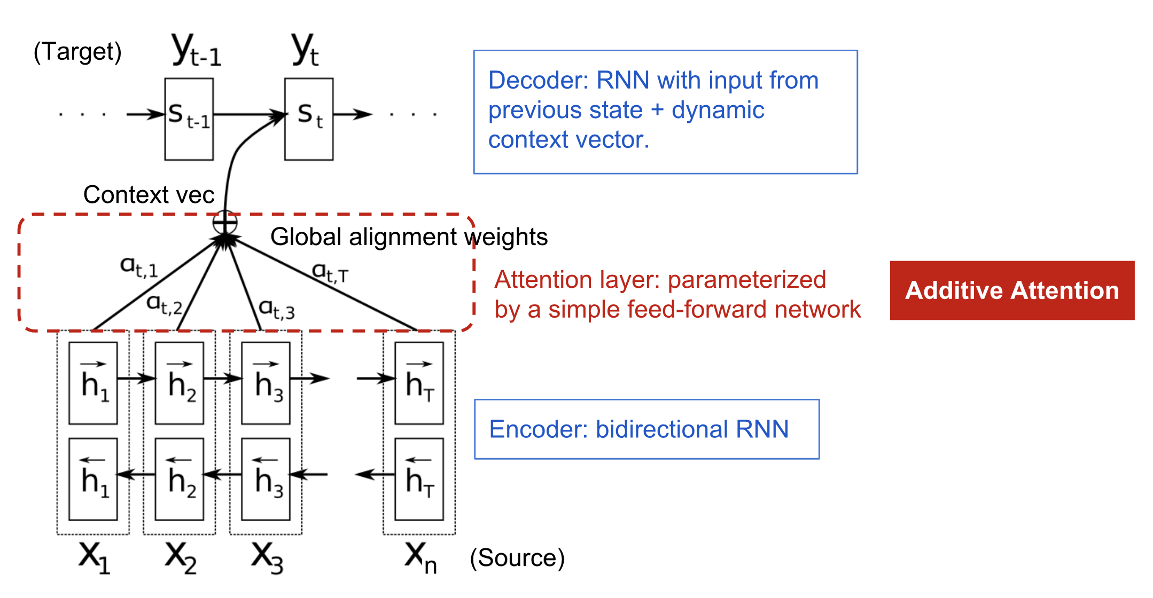
RNN with Attention

Slide 3
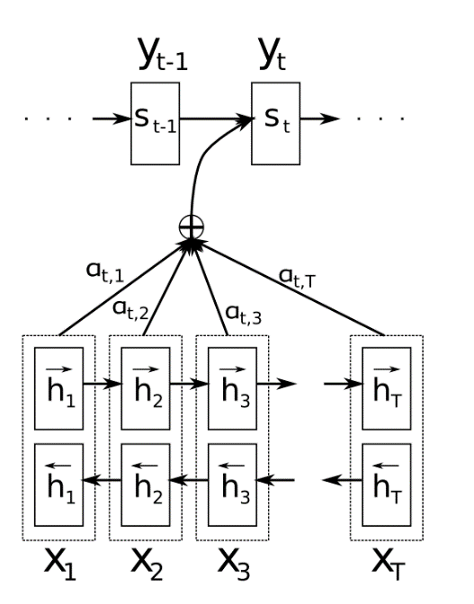
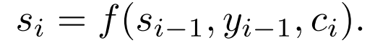
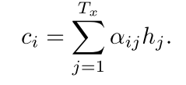
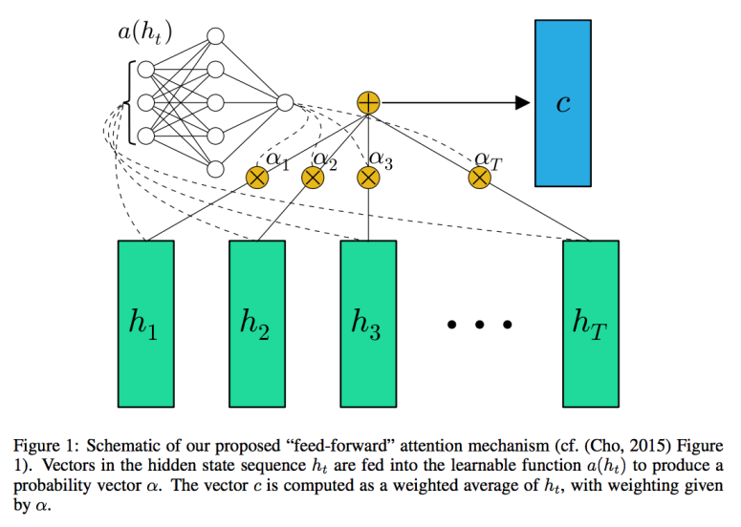
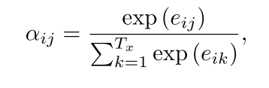
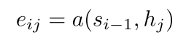
RNN with Attention
Output from RNN
Input to RNN
Context Vector
Weighted contribution from each time event
Softmax weighting
(attention/probability/weightage to input e.g. time event)
Neural Network
Source : https://miro.medium.com/max/2204/1*ABkaR2glZNP6oh08oY4l-Q.png

Slide 4
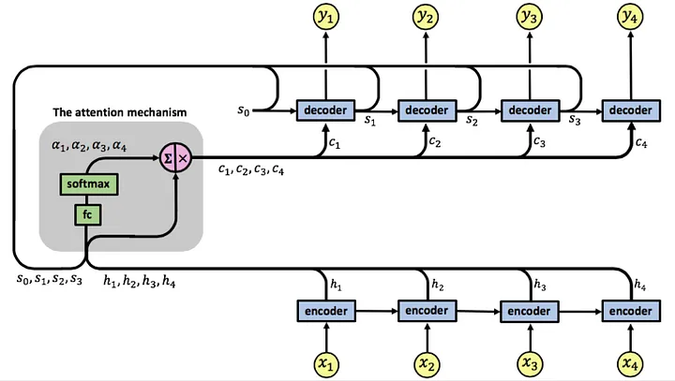

Slide 5
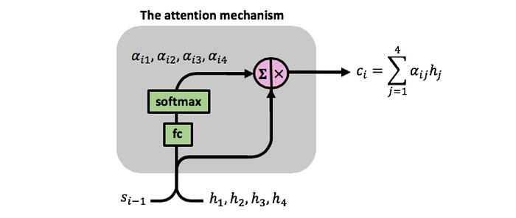
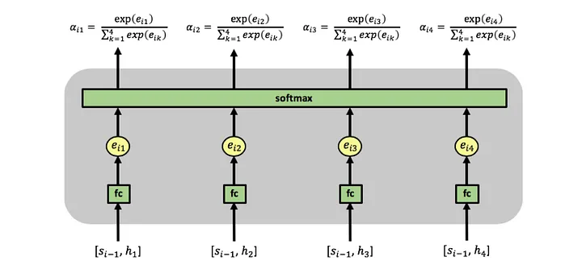

Slide 6
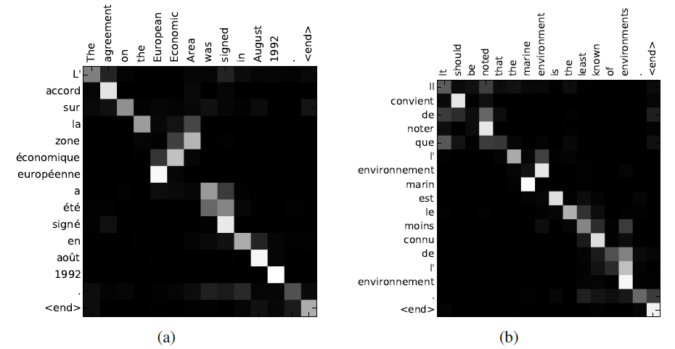
RNN with Attention
Example, Machine Translation
Bahdanau et al, “Neural Machine Translation by Jointly Learning to Align and Translate”, ICLR 2015

Slide 7


Transformer

Slide 8
Why Transformer ? Not RNN (LSTM) with attention
The maximum Path Length for long-range dependencies for a transformer is O(1) while for RNN is O(n)
Transformer allows parallelization, however, it is not true for RNN

Slide 9
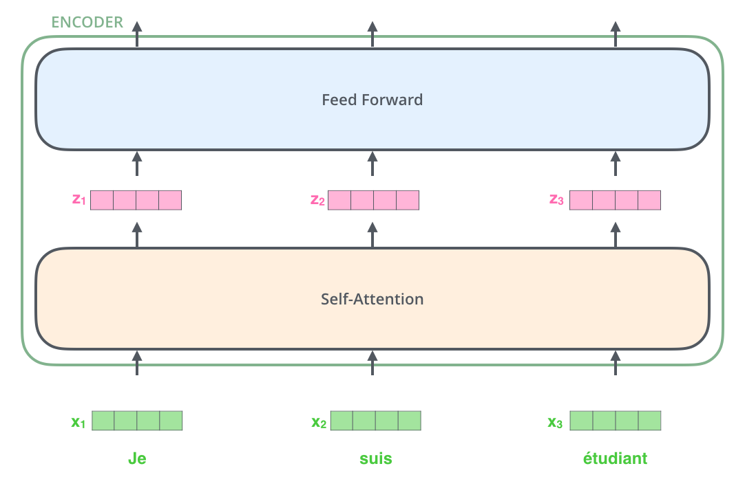
key property of the Transformer, which is that the word in each position flows through its own path in the encoder
There are dependencies between these paths in the self-attention layer

Slide 10

Self Attention
Transform the Embedding into Query, Key and Value representation
Learnable Parameters
(parameter sharing across time !!!, self-attention!!!)

Slide 11
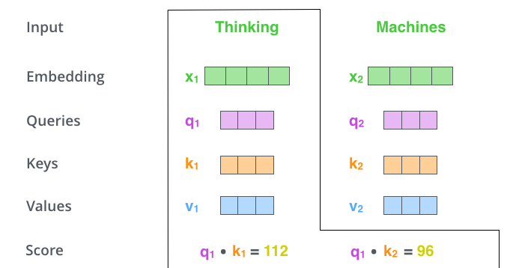
Self Attention
Self-Attention, learning interaction among the words !!!
Matching query with key !!!

Slide 12
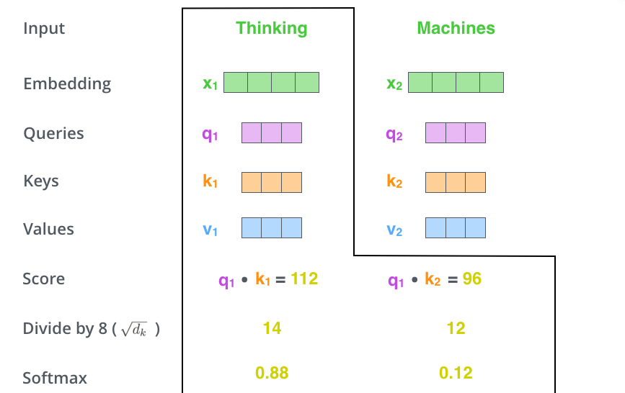
Self Attention
divide the scores by 8 (the square root of the dimension of the key vectors used in the paper – 64.
Softmax normalizes the scores so they’re all positive and add up to 1.

Slide 13

Self Attention
Weighted summation of value vector

Slide 14
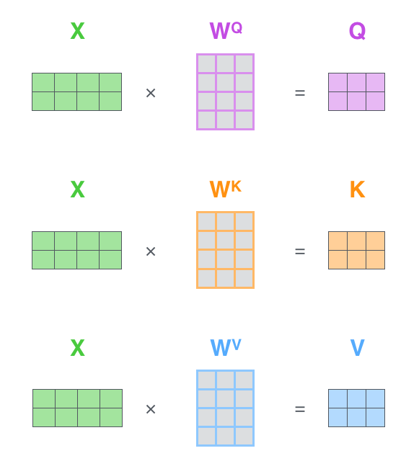

Self Attention
In Matrix Operation
Sentence length

Slide 15
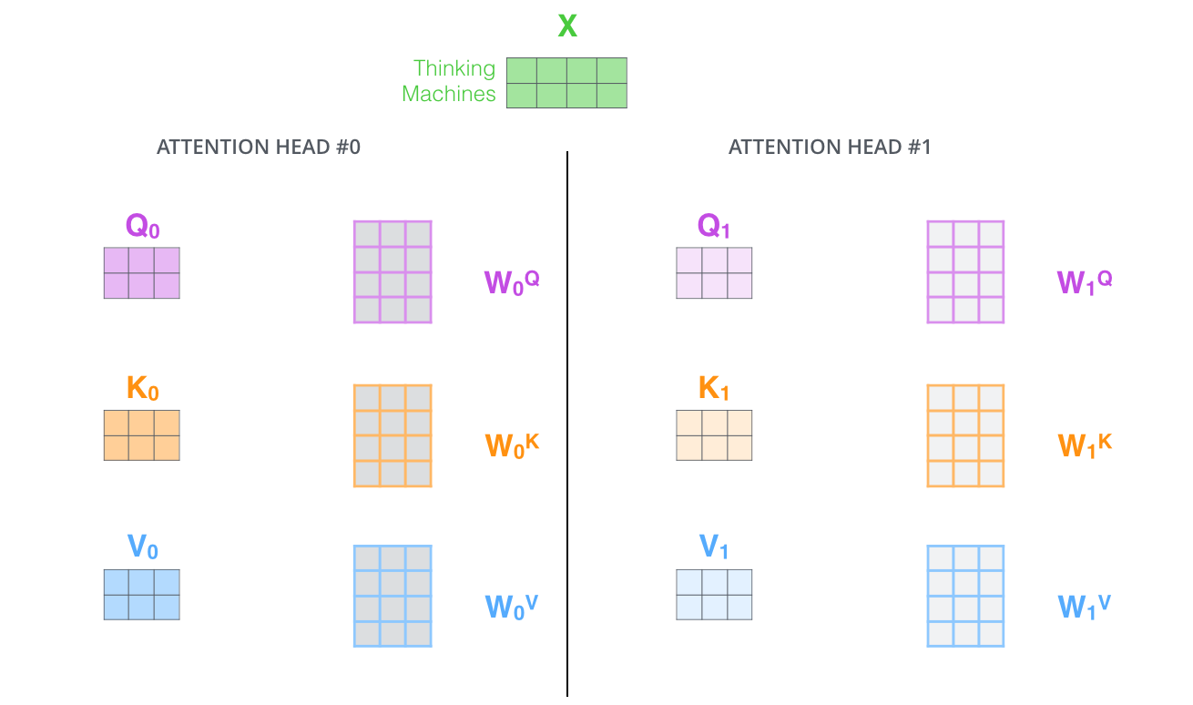
Multi-Head Attention

Slide 16
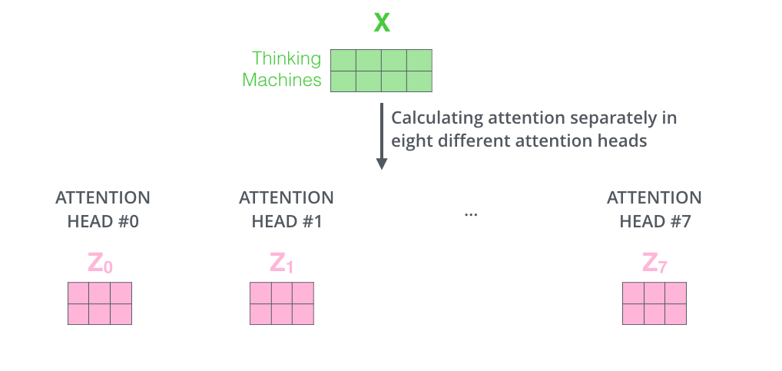
Multi-Head Attention

Slide 17
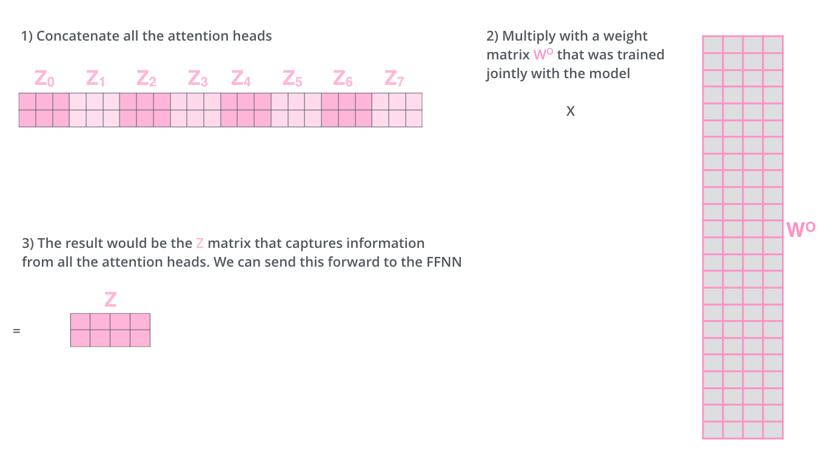

Multi-Head Attention

Slide 18
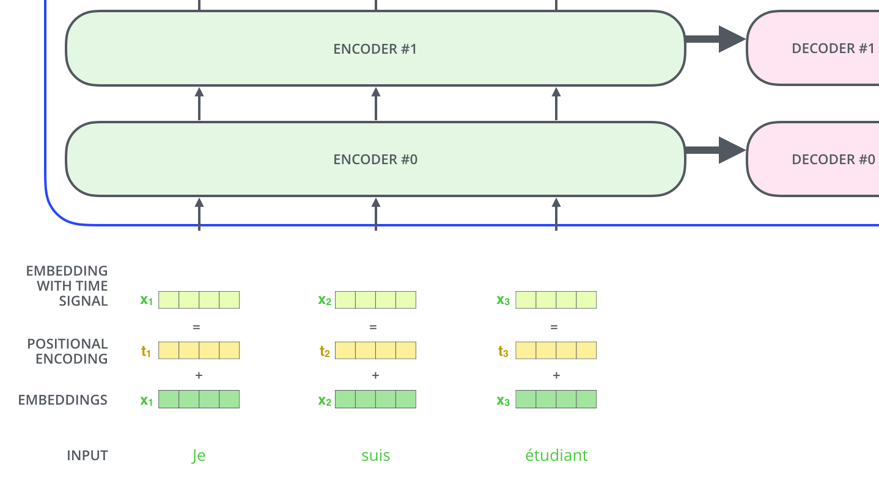
Positional Encoding

Slide 19
Positional Encoding

Slide 20
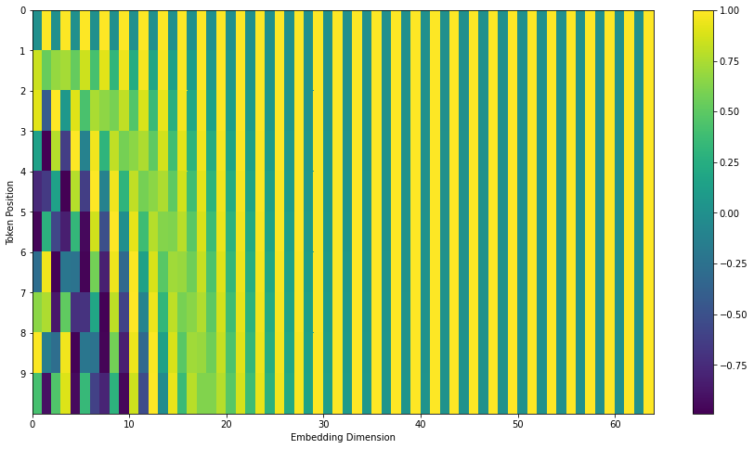
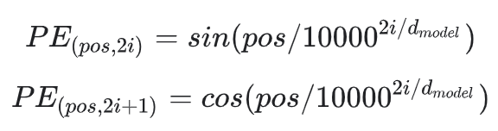
Positional Encoding

Slide 21

Skip Connections/LayerNorm

Slide 22
Decoder

Slide 23


Decoder

Slide 24
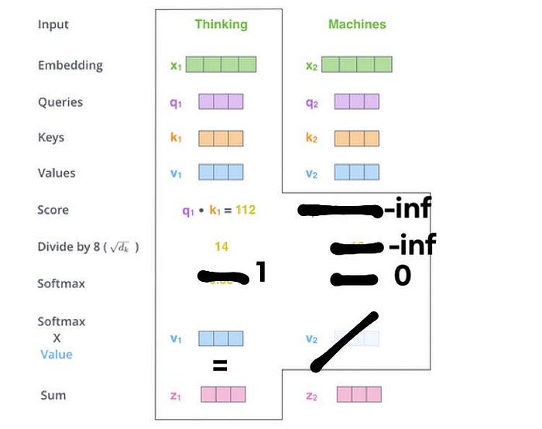
Masked Multi Head Attention
Not that input to decoder is variable the previous outcomes

Slide 25
Think….
How the transformer is different from RNN?
How the transformer is different from ANN?
Why does the transformer work?
What is the modification you may think of?
Why a vision transformer over standard CNN-based architecture?

Slide 26
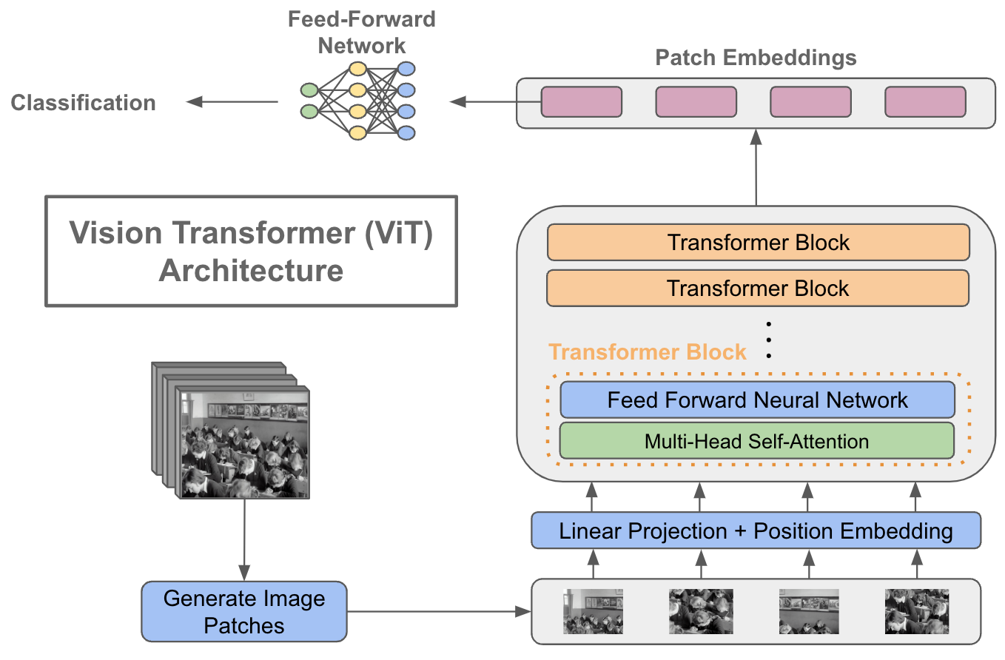
Vision Transformer (ViT)

